Slide 1
Judgemental Topics in Actuarial Education and Research
Jo Lo
Getting Better Judgment Working Party

Slide 2
Background & Motivation

Slide 3
It’s an important subject to practitioners

Slide 4
Why do we care?
Actuaries are responsible for recommending reserves, pricing, capital requirements, …
… not only for what comes out of models
Data
Judgment
Model
Actuarial Output

Slide 5

A Disturbing Example
Biases abound in courtrooms
Sentencing can depends on…
Before or after meal times
Irrelevant dice rolls

Slide 6
Why should we care?
Materially Biased Judgments
Unreliable Numbers
Wrong Business Decisions

Slide 7
Cognitive heuristics and biases
Small Sample Bias
Anchoring
Overconfidence
Deliberate Bias
Availability
Framing
Answering Easier Question

Slide 8
Model vs Judgment
High research bias in model
In practice both are important
E.g. stochastic reserving

Slide 9
Agenda
Background & Motivation
Recent Actuarial Studies
Dedicated and Scientific Research
Implications for Actuarial Education
Conclusions

Slide 10
Recent Actuarial Studies
General Insurance Viewpoint

Slide 11


Why Judgemental Research in GI?
Vast amounts of research exist external to actuarial science
E.g. Kahnemann and Tversky
Why should we bother?
Their and others’ conclusions are vulnerable to various criticisms:
Subject matter relate to trivia rather than projecting into the future
Subjects are students and not practising professionals
Experimental conditions are not real-life enough – e.g. we could have time to think slow in reality
…

Slide 12
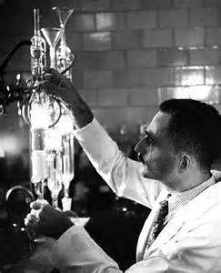
Recent Attempts
Practitioners: high level – raising awareness
Don Mango – GIRO 2012
Phil Ellis & Clare Barley – GIRO 2013
Graham Fulcher – The Actuary
Jo Lo, Ed Tredger & Bernadette Hlavka – The Actuary
In more detail / empirical experiments:
Lo, Patel & Calder: Underwriters & Analysts
IFoA Getting Better Judgment Working Party
To come: ASTIN Working Party on Expert Judgment - 2015
Actuarial academic research – a couple of papers in underwriter decision-making / pricing

Slide 13
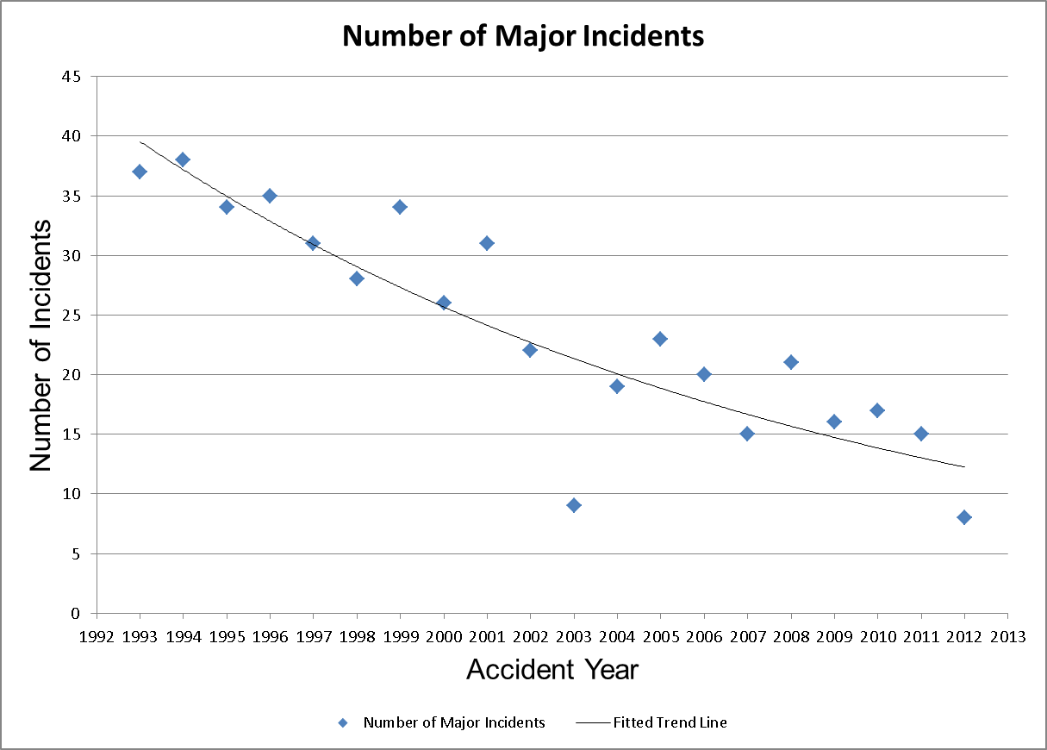
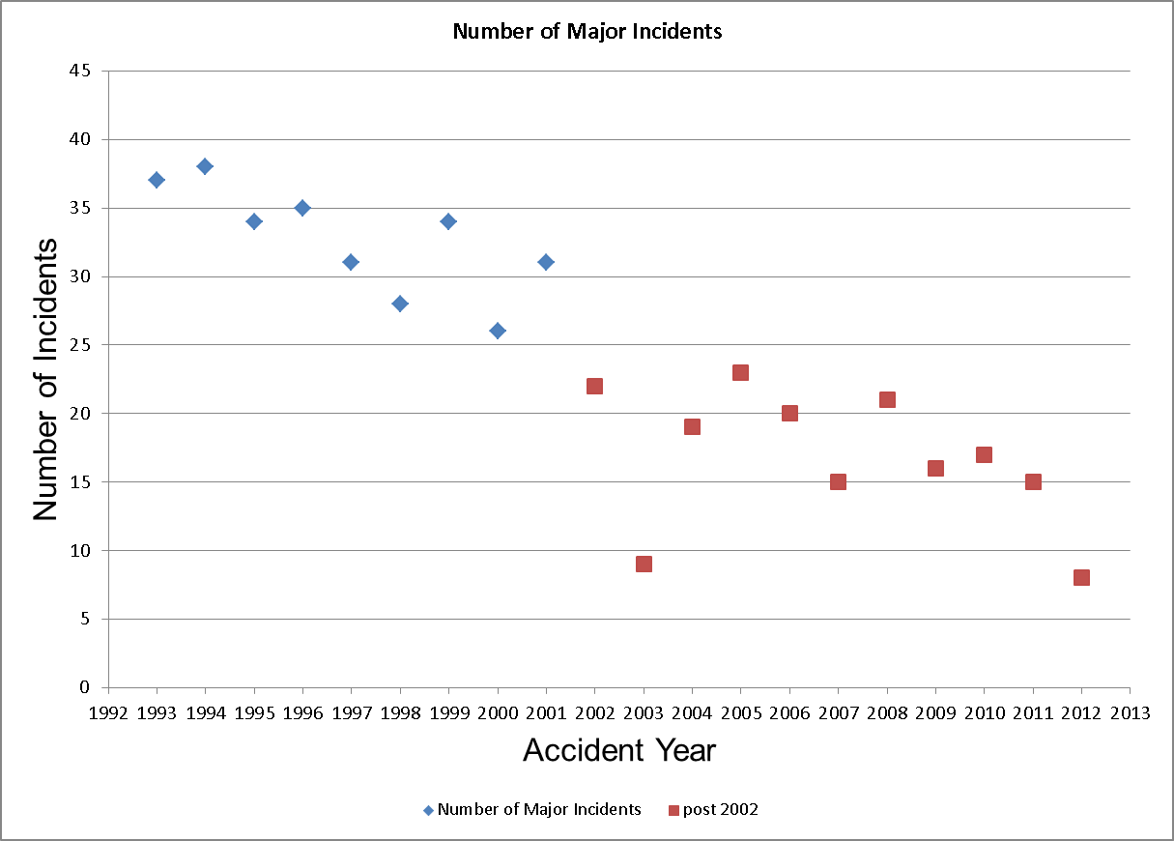
Different Interpretations of Data

Slide 14
Interaction with Experts

Slide 15
Dedicated and Scientific Research

Slide 16
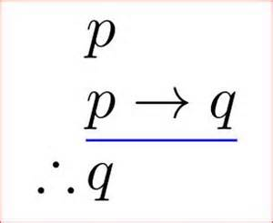
One particular method
Actuarial scientific research dominated by a particular method
Axioms / Assumptions → Deductions
Sets logical bounds
e.g. VaR diversfication / anti-diversification
Allows organisation of data to meaningful statistics slickly

Slide 17
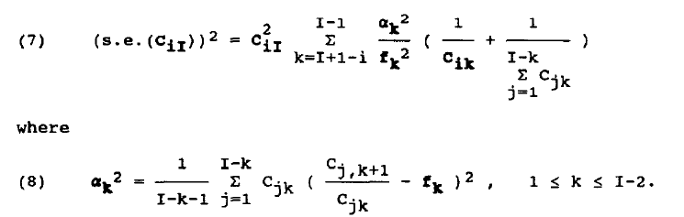
Why are these formulas useful?

Slide 18
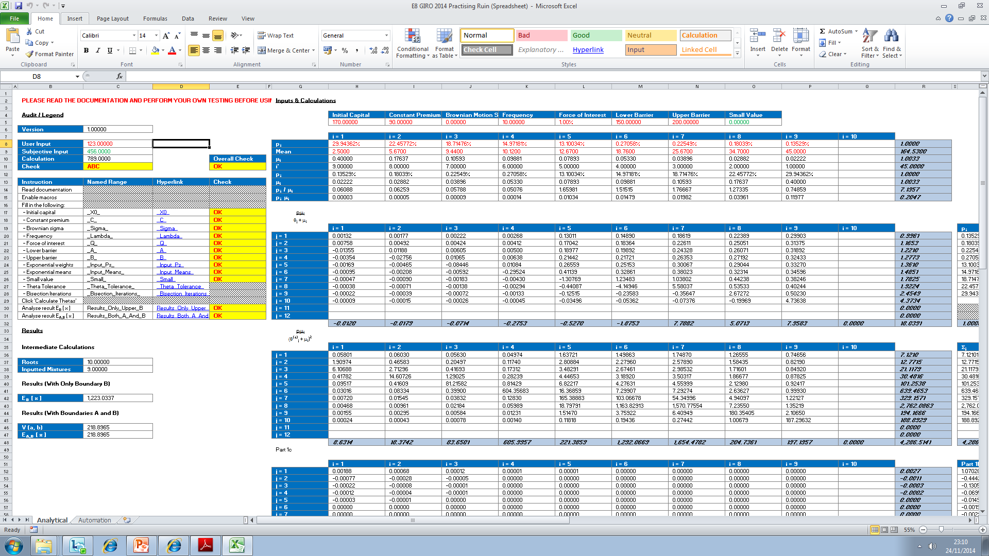
Or this spreadsheet?

Slide 19
Science has not always been like this
Form reasonable hypotheses
Design experiments to test hypotheses
Implement experiments
Reasonable conclusions join body of knowledge

Slide 20
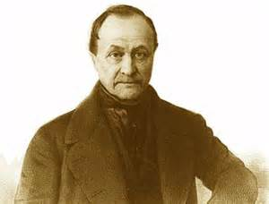
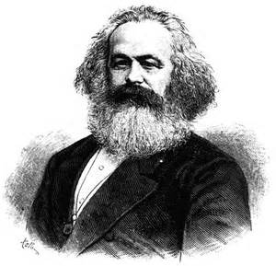
Which is “The Queen Science”?
Social sciences, psychological research, management science, …
Knowledge can still be progressed rigorously
Even if never with absolute certainty
Judgemental research takes this approach
Do not underestimate the power of social sciences!

Slide 21
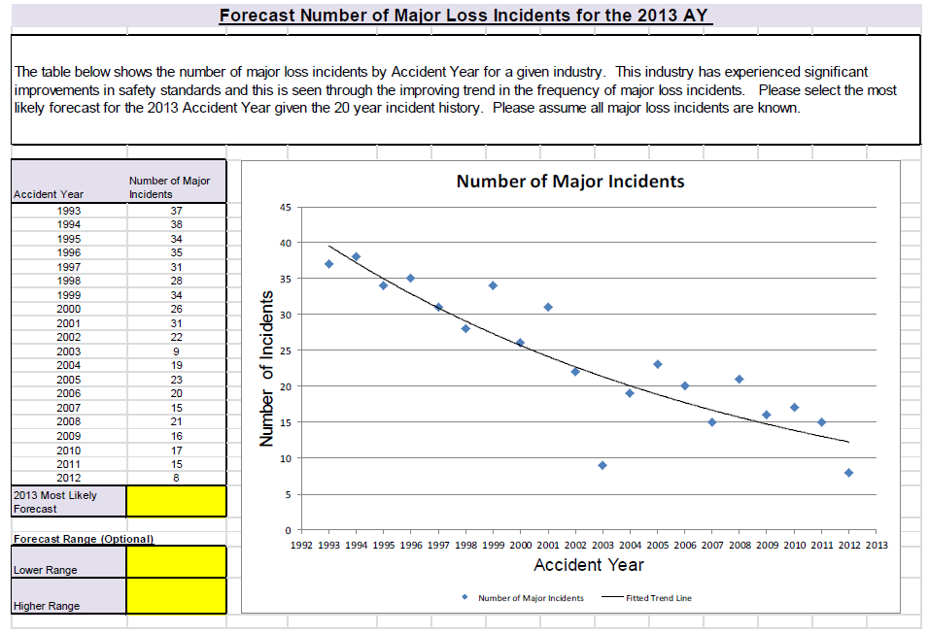
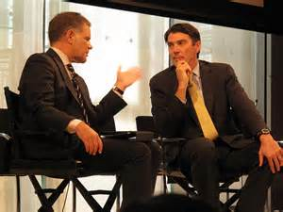
Example Methods
Questionnaires
During seminars
Own time
Longer sessions
In-depth Interviews

Slide 22
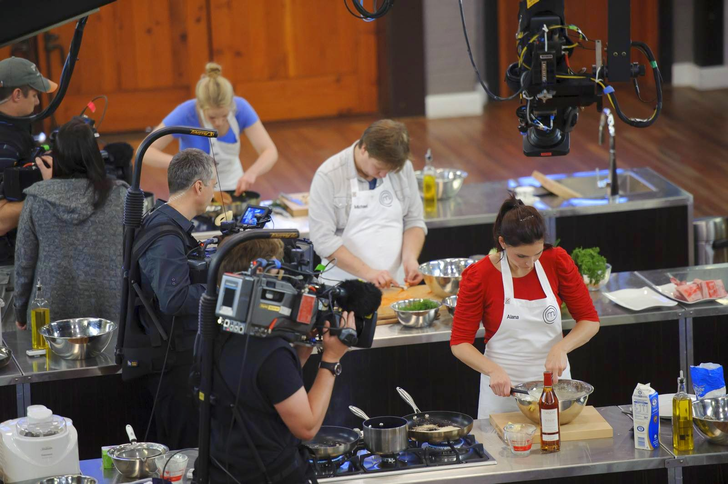
Large-scale Competitions

Slide 23

Stories – rich source of data
Collecting of “war stories” can also be important
Survey suggests these could be a way forward for practitioners
Could form bases for forming reasonable hypotheses to scientifically test

Slide 24

Dedication
Have enough time to perform research is critical for all stages
Funding for both researcher and as incentives for subjects
These recent attempts were not easy
Most difficult factor is that of time and funding
Both done on an “extracurricular” basis – both mainly by practitioners outside their job descriptions, on a volunteer basis
Funding limited for small prize like book and drink prizes

Slide 25
Multi-disciplinary Approach
“These are high risk projects”
“Might someone else have done this research before”
“I need to publish in journals with high rating”
“Multi-disciplinary research very much encouraged and there is funding”
“Let’s do good research and worry about journals afterwards”

Slide 26
It is very valid for actuarial scientists to engage in judgemental research!
Could be scientifically rigorous
Requires dedicated resource
And multi-disciplinary approach
It is very relevant for practitioners
And have potential wide-ranging impact

Slide 27
Implications for Actuarial Education

Slide 28
Fit for purpose?
Can we teach everything?
Ready to serve the public interest, in a business environment?

Slide 29
Updating with New Data – without training

Slide 30
Updating with New Data – with training

Slide 31
Actuarial Syllabus
Very little mention of expert judgemental topics
Two ways:
Could pepper judgemental issues throughout all technical courses
Could have another paper in the syllabus
Communication:
Is there scope for this to be two-way communication?
Study material / syllabus will require collaboration of practitioners and judgemental experts

Slide 32
Actuarial Science B.Sc. / M.Sc. courses
“A graduate who can demonstrate awareness working with experts stands at advantage to one who cannot”
“This is a soft skill learnt through on-the-job training”
Most students do not go on to do Ph.D. research
They want to find a job and be successful at it!

Slide 33
Conclusions

Slide 34
Agenda
Background & Motivation
Recent Actuarial Studies
Dedicated and Scientific Research
Implications for Actuarial Education
Conclusions

Slide 35

Research – influential, multi-disciplinary – even if not risk-free
“These are high risk projects”
“Might someone else have done this research before”
“I need to publish in journals with high rating”
“Multi-disciplinary research very much encouraged and there is funding”
“Let’s do good research and worry about journals afterwards”

Slide 36
Education – working with expert judgement is an important skill to nurture
Ready to serve the public interest, in a business environment?
Can we teach everything?
“A graduate who can demonstrate awareness working with experts stands at advantage to one who cannot”
“This is a soft skill learnt through on-the-job training”

Slide 37
Working Party Plans
All planned interim conference presentations in 2014 have now been given
Development and consolidation of ideas
Write up of paper – Mid 2015?

Slide 38
Working party members
We would love to hear from you!
Working Party Members | Sectors (Employers) | Actuarial Activities | At ATRC?
Bernadette Hlavka | London Market (Tokio Millennium Re) | Pricing, capital
Catherine Scullion | Public Sector (GAD) | Pricing, fin. modelling and risk mgt.
Ed Tredger | Consultancy (UMACS) | Capital, pricing, software
Helen Lau | General Insurance (Allianz) | Capital
Jo Lo (chair) | London Market (Aspen) | R&D, actuarial modelling, risk mgt. | Yes
Michael Garner | London Market (Atrium) | Capital, reserving, pricing
Nick Bonello | London Market (ANV) | Capital
Sejal Haria | Regulator (PRA) | Risk mgt., fin. modelling, business strategy
Steven Fisher | Consultancy (LCP) | Capital, reserving

Slide 39
Questions
Comments
Expressions of individual views by members of the Institute and Faculty of Actuaries and its staff are encouraged.
The views expressed in this presentation are those of the presenter.

